Slide 1
Principles of Plant Systematics II
A Quick Review
And
Some Fun!

Slide 2
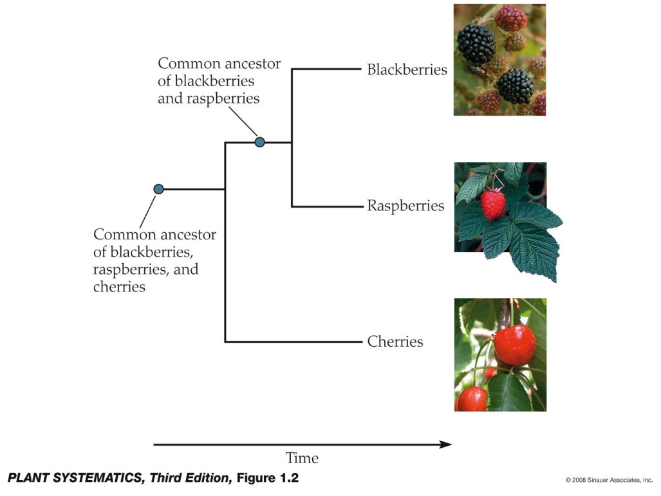
Monophyletic Group (= Clade)
A group composed of an ancestor and all its descendants.

Slide 3
Synapomorphy
Shared derived character state.
Synapomorphies have arisen in a common ancestor and are present in all the members of a group though sometimes in modified form.
Synapomorphies can be morphological, chemical, genetic, behavioral, etc.

Slide 4
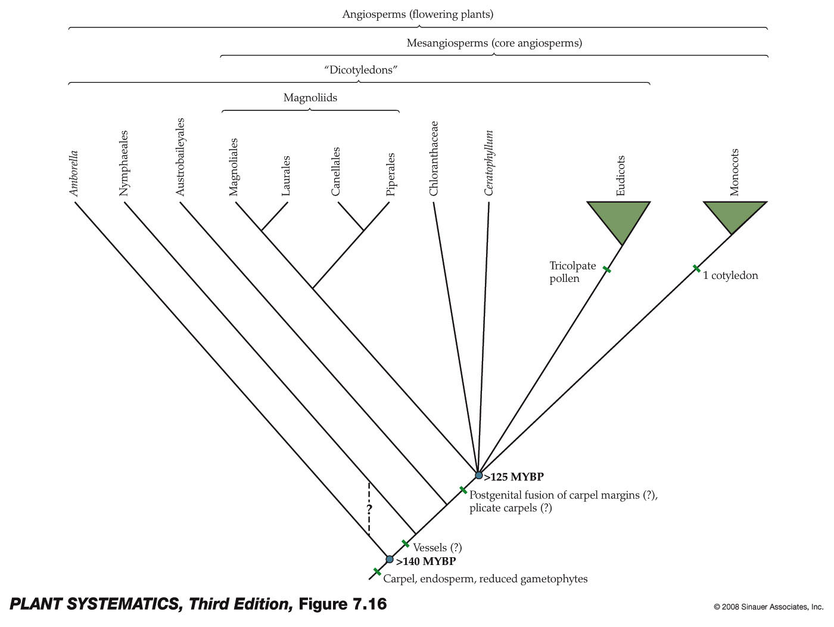
Phylogenetic Tree (= Cladogram)

Slide 5
What Assumptions/Problems Are There in Cladistics?
1. Change in characteristics occurs in lineages over time.
2. Any group of organisms is related by descent from a common ancestor.
3. There is a bifurcating, or branching, pattern of lineage-splitting. (when a lineage splits, it divides into exactly two groups)
4. Changes occur in an orderly progression, i.e. ordered. (pg. 26 of J&C)
5. Jumps between lineages (hybrids) aren’t easily dealt with
6. If we assume “parsimony” we are sometimes fooled.
7. Reversals and Convergence (Homoplasy) difficult to deal with

Slide 6
Let’s Construct Our Own Phylogenetic Tree (Cladogram)
Consider the following four plants that grow here locally in the Gila National Forest as representatives of their families:
Urtica dioica (Stinging Nettle, Urticaceae)
Ceanothus greggii (Desert Buckthorn, Rhamnaceae)
Morus microphylla (Littleleaf Mulberry, Moraceae)
Ulmus pumila (Siberian Elm, Ulmaceae)

Slide 7
Consider These Three Character States:
Flower size: conspicuous, or inconspicuous
Stamens: >5 & straight, or <5 & incurved
Sap: Milky, or clear

Slide 8
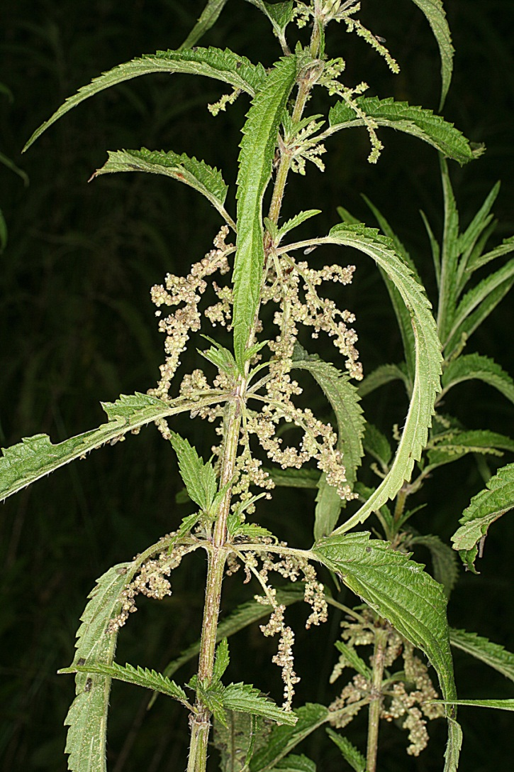
Urtica dioica subsp. gracilis

Slide 9
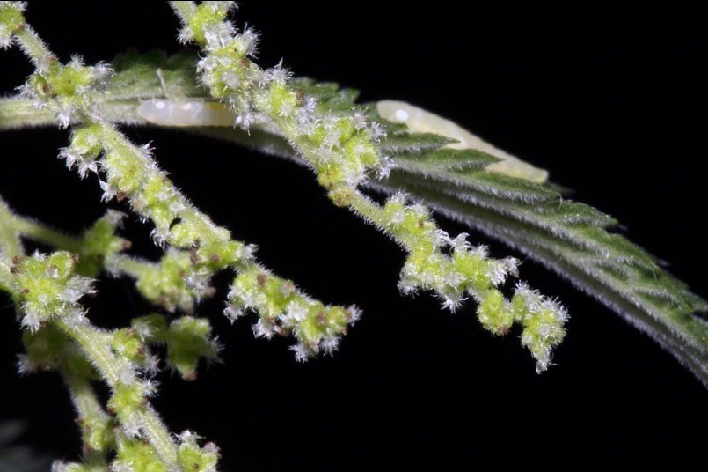
Urtica dioica subsp. gracilis

Slide 10
Urtica dioica subsp. Gracilis
Character states
Flower: inconspicuous
Stamens: 4, incurved
Sap: at least somewhat milky

Slide 11
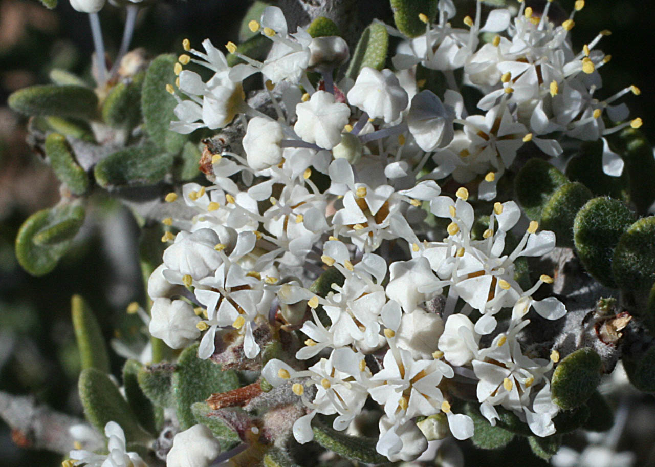
Ceanothus greggii

Slide 12
Ceanothus greggii
Character states
Flower: conspicuous
Stamens: 5, straight
Sap: clear

Slide 13
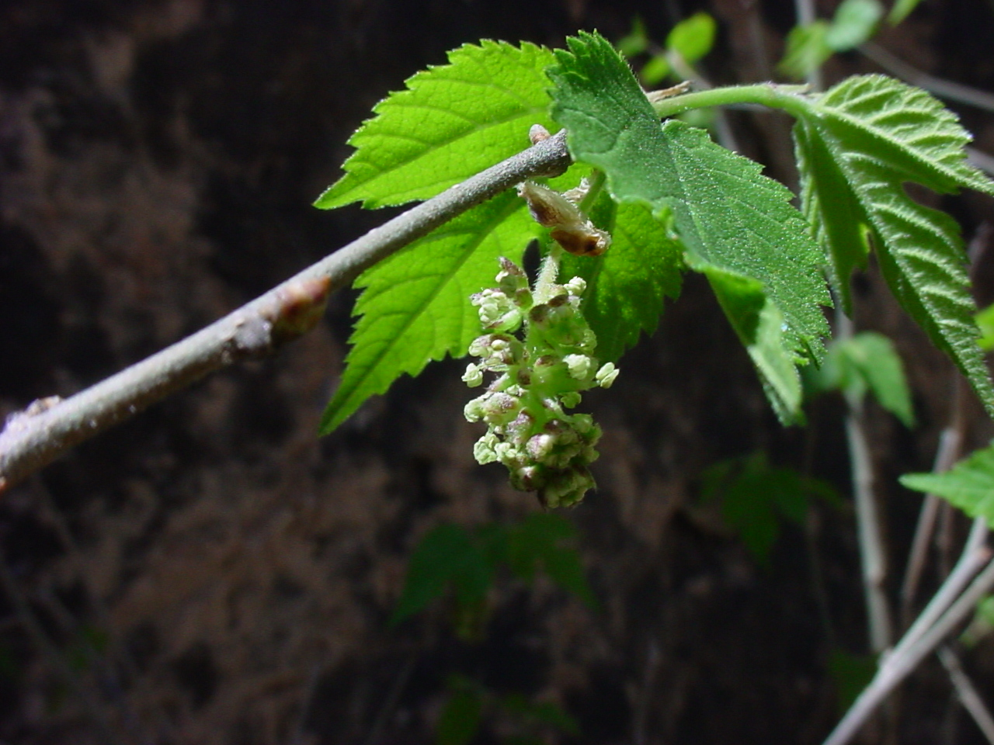
Morus microphylla

Slide 14
Morus microphylla
Character states
Flower: inconspicuous
Stamens: 5, straight
Sap: milky

Slide 15
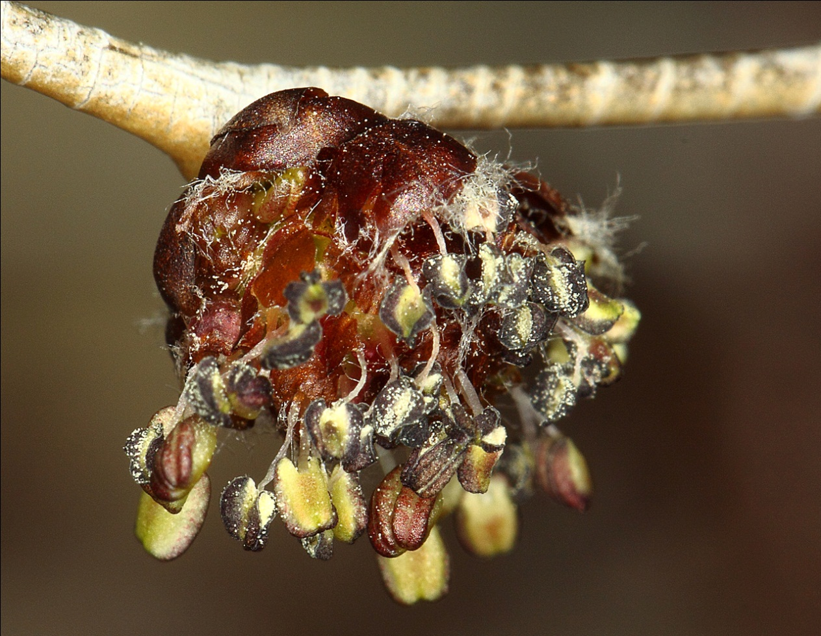
Ulmus pumila

Slide 16
Ulmus pumila
Character states
Flower: inconspicuous
Stamens: 5, straight
Sap: clear

Slide 17
Construct a Matrix…
 | Flower Type | Stamen Type | Sap Type
Urtica gracilis
Ceanothus greggii
Morus microphylla
Ulmus pumila

Slide 18
Construct a Matrix
 | Flower type | Stamen type | Sap type
Urtica gracilis | inconspicuous | 4, incurved | milky
Ceanothus greggii | conspicuous | 5, straight | clear
Morus microphylla | inconspicuous | 5, straight | milky
Ulmus pumila | inconspicuous | 5, straight | clear

Slide 19
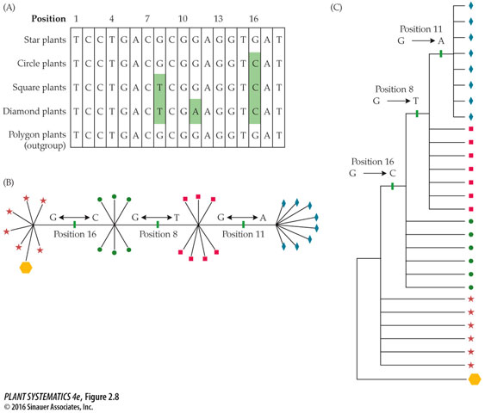

Slide 20
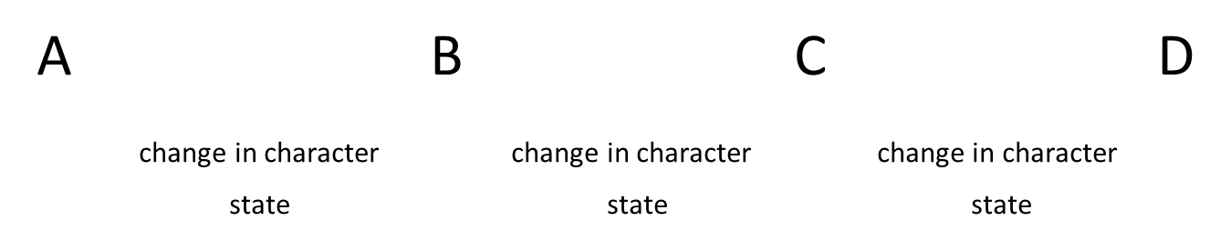
Make Your Network

Slide 21
Make Your Network
Ceanothus greggii Ulmus pumila Morus microphylla Urtica dioica
A B C D
flower state type of sap stamens
conspicuous inconspicious clear milky >5, straight <5, incurved

Slide 23
What Do You Need to Root the Network?
You need an outgroup
Outgroups are assumed to have separated from the ingroup lineage before the ingroup diversified; i.e., the ingroup members are more closely related to each other than they are to the outgroup.
The point at which the outgroup attaches to a network is therefore determined as the root of the tree.

Slide 24
Add the the Outgroup
Let’s use Rosa woodsii as a representative of the Rosaceae as the outgroup.
Here are the character states of Rosa woodsii:
Flower: conspicuous
Stamens: >5
Sap: clear
Now– root your network by attaching
Rosa woodsii at the most appropriate spot.

Slide 25
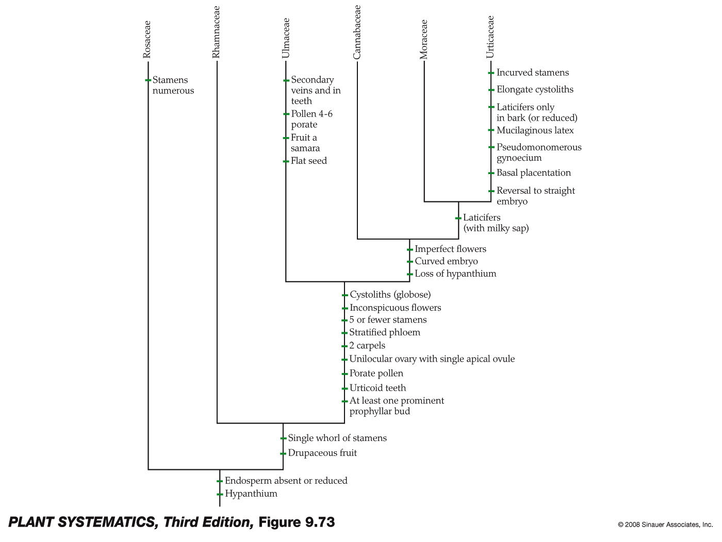
Congrats! Meet the Rosales!

Slide 26
Reading Assignment:
Morphology of Vegetative Structures: Judd and Campbell pp. 65-73

